Slide 1
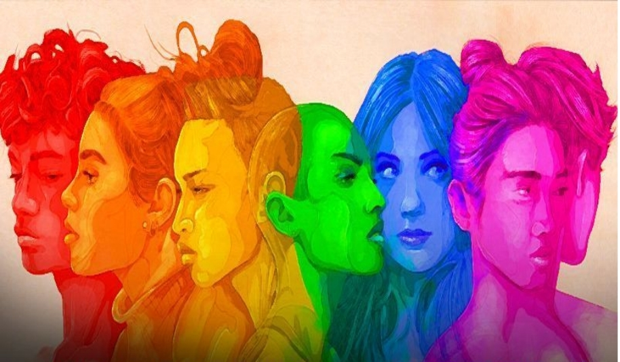

RAINBOW AFRICA INITIATIVE QUARTERLY DIGEST

Slide 2
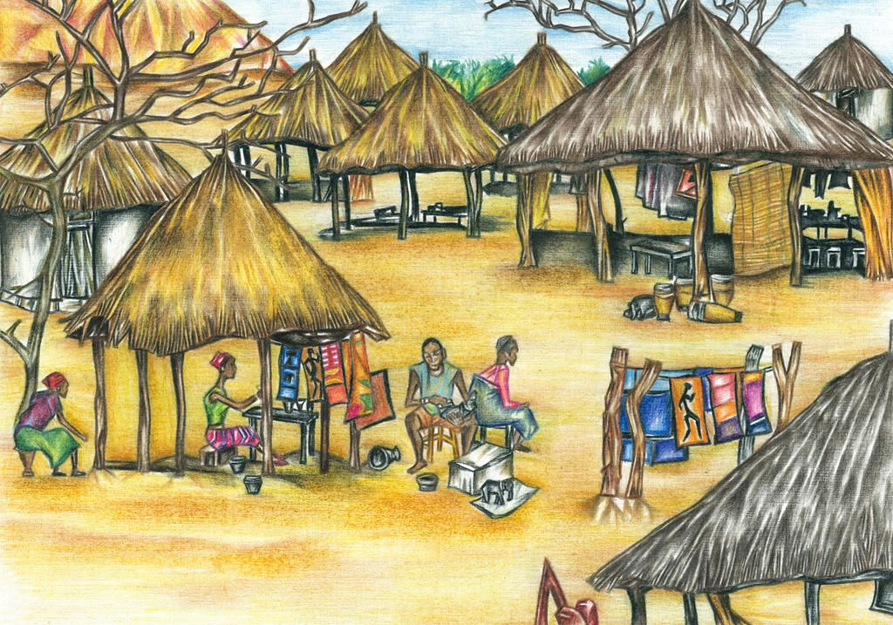
A BRIEF ABOUT RAINBOW AFRICA INITIATIVE
Rainbow Africa Initiative was formed by a group of Queer feminist sex workers youth in late 2016 who were passionate about improving service delivery module to their community in the areas of Sexual Reproductive Health and Rights to advance livelihood for the marginalized youths. The need for improvement came about to address needs and challenges faced by the queer feminist sex-worker youths who were so vulnerable when it comes to accessibility to these services. The rising numbers of stigma and discrimination in rural areas hence called for action for change in gaps like human rights, health, advocacy, economic justice and capacity development. Through partnership and networking modules, RAI-Ug strategizes to address the challenges through resource mobilization and partner implementation to have a strong movement whereby everyone is included and not discriminated. The Initiative was formed in the suburbs of Kampala, Uganda and later took action in the rural setting of Kabarole to address the desired concerns of SRHR.
GOAL: To achieve SRHR accessibility for rural marginalized queer feminists and sex-worker youths communities in Uganda.
VISION: Equality and Equity in provision of SRHR services to rural marginalized queer feminists, sex-worker youths and adolescents in Uganda.
MISSION: To advocate for the engagement of rural marginalized queer feminists and sex-worker youths in the empowerment and inclusion in the SRHR strategic policies.
LEARN MORE

Slide 3
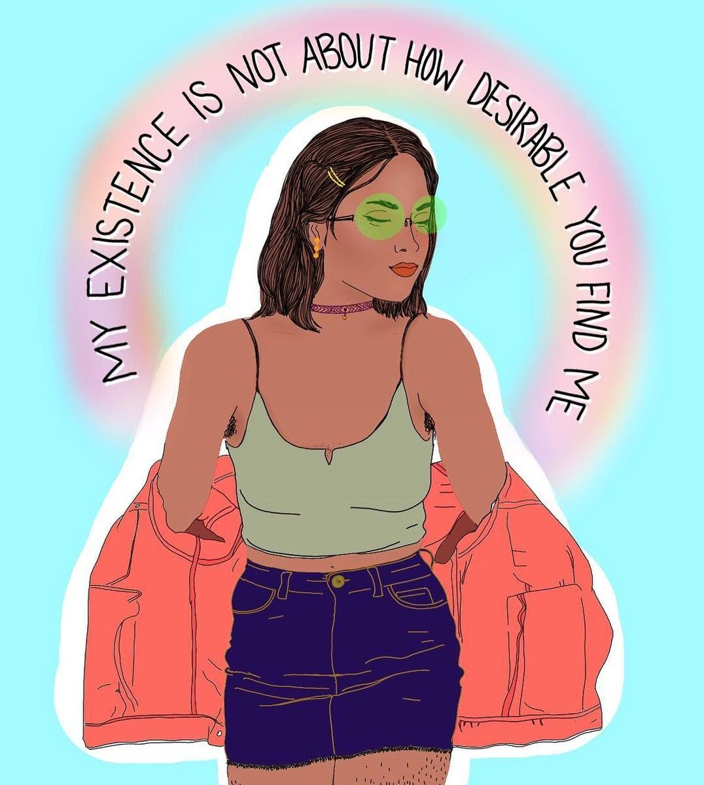

Dear Friends, we are thrilled to share the third quarter of 2022 updates from the Rainbow Africa Initiative with you. Please take time and look through our initiatives toward the rural queer feminist sex-workers youth community services delivered. Considering our scope reach, this quarter was focusing on digital security and movement building to better effectiveness of the rural community into the SRHR programs. With support from donors and partnerships with other CSOs, we managed to achieve the following projects as stated in this brief. This quarterly reflection will introduce to you what we basically do as an organization.
Happy Reading!

Slide 4

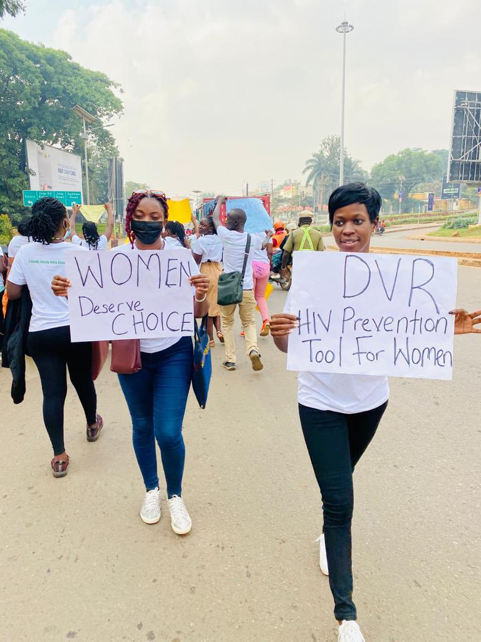
SEXUAL REPRODUCTIVE HEALTH INTEGRATION FOR RURAL QUEER SEX WORKER COMMUNITY

Slide 5
Through this project, we were able to conduct community sensitization of Safe Abortion Care and Rights for rural sex workers in Kagote, Fort-Portal and also had a dialogue with adolescent school dropouts on prevention of teenage pregnancies. The integration program was conducted to help educate these rural minorities basic knowledge and also help map friendly health services providers that could be partnered with for peer referrals and linkages in case of need for the SRHR services. This was a success however due to limited resources, we were unable to conduct engagement meeting with the community and health service providers but went on to have stakeholder meetings to come up with memorandums of understanding on how best to engage both parties.
We participated in the online campaigns about dapivirine vaginal ring (DPV-VR) which is an additional prevention choice for women (mostly sex-workers) at substantial risk of HIV infection as part of combination prevention approaches. This was a collaboration with other health activists under the hashtags, #SRHRisEssential and #FundTheRingUG.

Slide 6
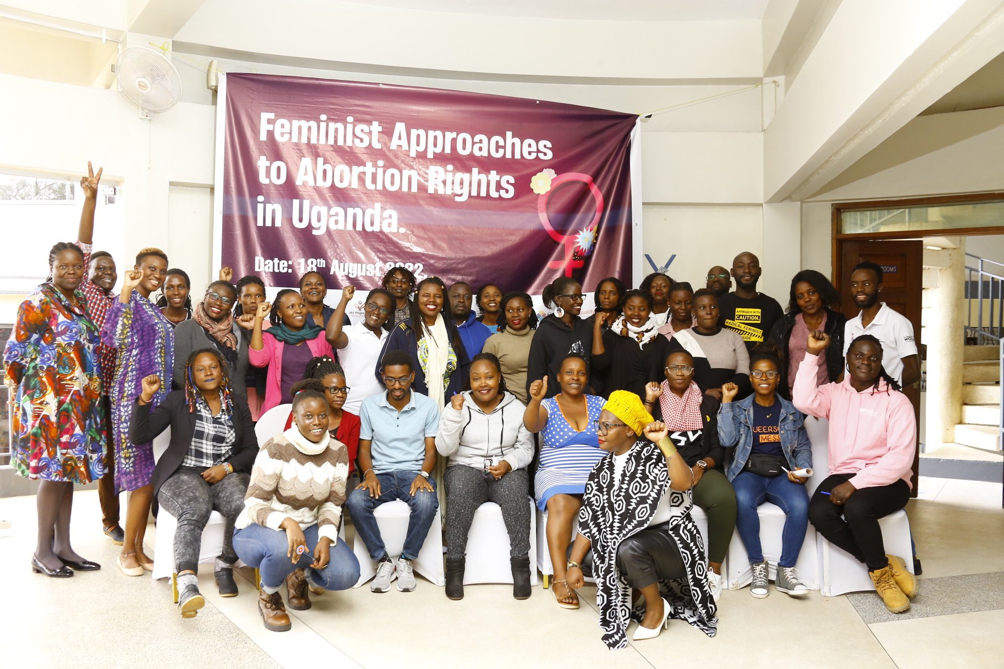
FEMINIST APPROACHES TO ABORTION RIGHTS IN UGANDA
We took part in the rethink space organized by Akina Mama wa Afrika which was to interrogate the feminist approaches to abortion access in Uganda.
Using the developed technical brief on feminist approaches to abortion to curate conversations on why abortion is a feminist issue and need feminist approaches if all women, girls and gender expansive persons are to access it.
This helped to discuss the The Legal and Policy Framework on Abortion in Uganda, The Politics of Abortion, among others.
Kudos Akina Mama wa Afrika!

Slide 7
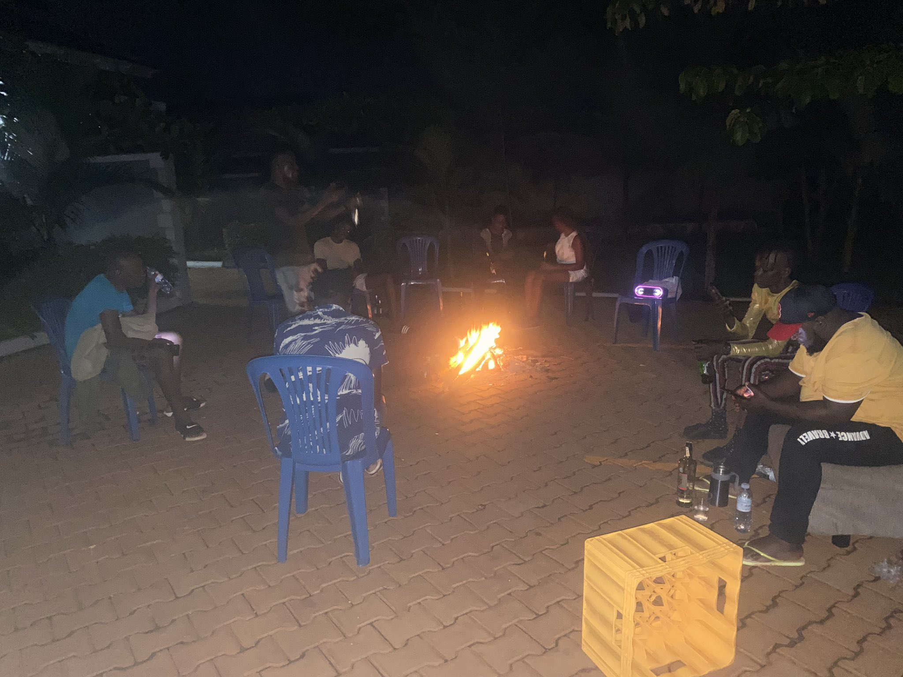
MOVEMENT BUILDING AND COLLABORATIONS
COMMUNITY NARRATIVE DIALOGUE:
Never can you change the community without engagement tackling the baseline issues. We believe that having social gatherings with our beneficiaries helps to ease the problem solving. We conducted the Ekyoto Tuhanule (bonfire) gathering that helps us to share and solve the challenges affecting our movement, take off the stress and network for a meaningful development.
This initiative helps us as an organization engage our peers and other members to share and uplift new strategies that would really help us to change the community.

Slide 8
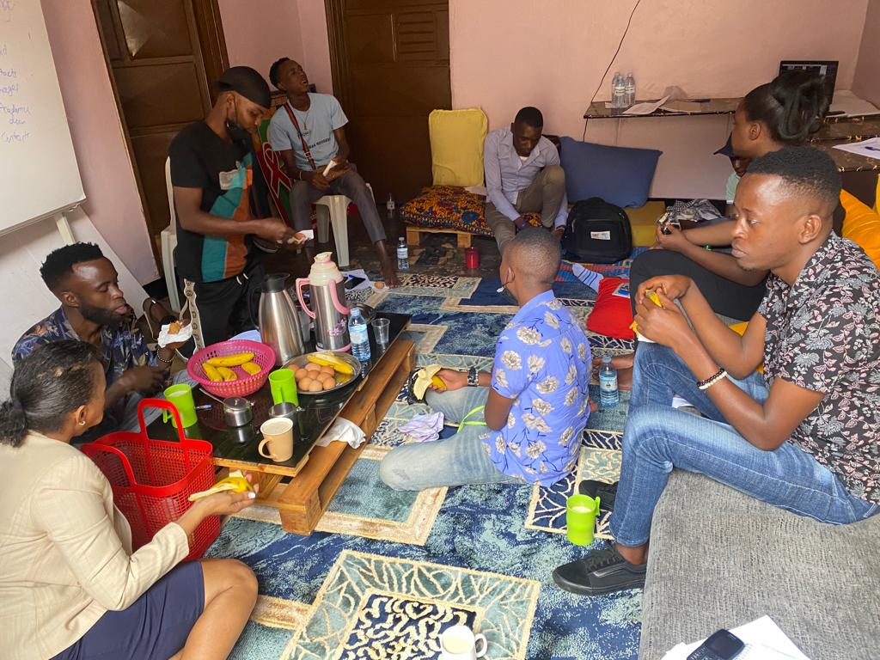
MENTAL HEALTH SHARING SESSIONS:
Group healing sessions help to resolve challenges that bring mental health illness. As an organization, we have conducted mental health sessions for peers which have geared group healing through sharing challenges that have impacted the high levels mental health disorders within the queer community. Through these sessions, we do monthly community community Sunday gathering, play games, sharing of bites, story telling and DYI. These have promoted teamwork and togetherness among our peers which has helped in conflict resolution among community members and improved the networking systems.

Slide 9
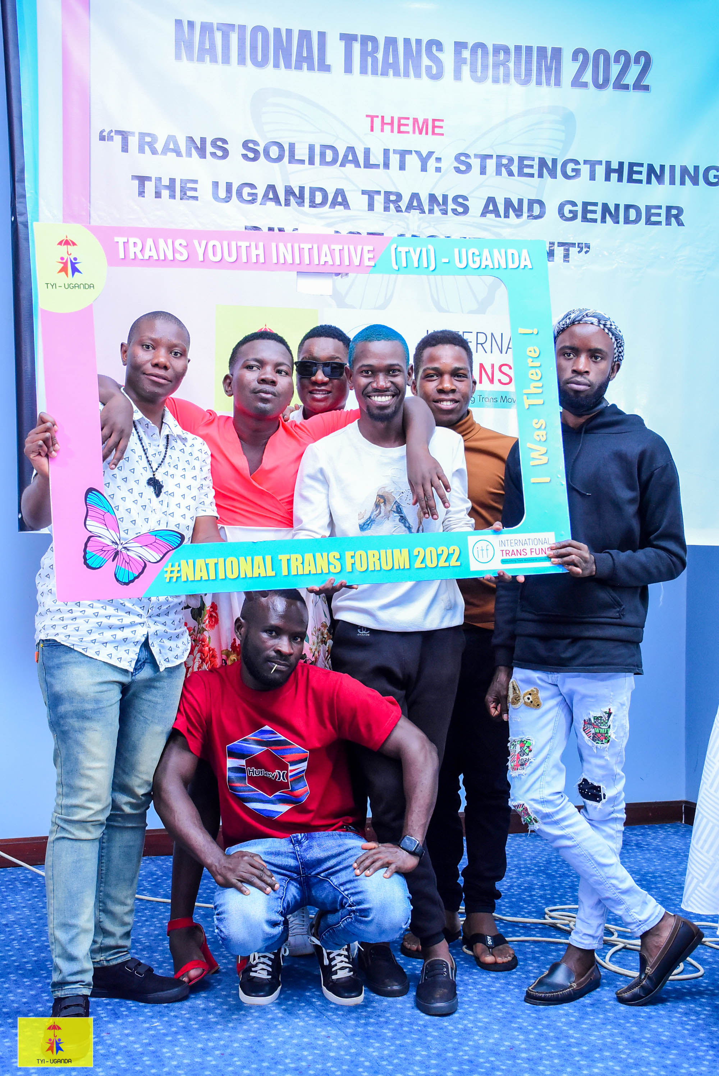
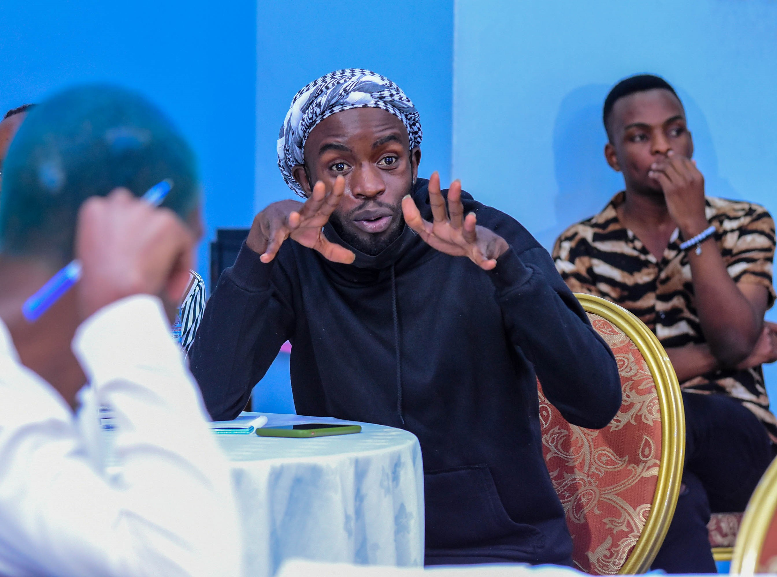
TRANS AND GENDER DIVERSE MOVEMENT BUILDING:

Slide 10
With program implementation, Trans Youth Initiative - Uganda organized the first ever National Trans Forum under the theme "TRANS SOLIDARITY: STRENGTHENING THE UGANDA TRANS AND GENDER DIVERSE MOVEMENT." This was a space utilized to share knowledge on how best to improve the Trans movement and communities in Uganda. We were able to table the challenges faced by the rural queer communities that we serve as an organization.
It helped us to take part in strategizing and conducting resource mobilization as a whole for the communities we serve. Under this initiative, various committees were formed to engage CSOs and their beneficiaries on the key aspects of leadership development and better service delivery.
Strengthening the movement, we engaged in a a three-year strategic project planning meeting to guide in the implementation of proposed priorities and interventions at the national trans forum in order to build a strong, adaptable, tenacious, representational, and self-sufficient trans and gender diverse movement in Uganda able to advance the concerns of trans and gender diverse communities.

Slide 11
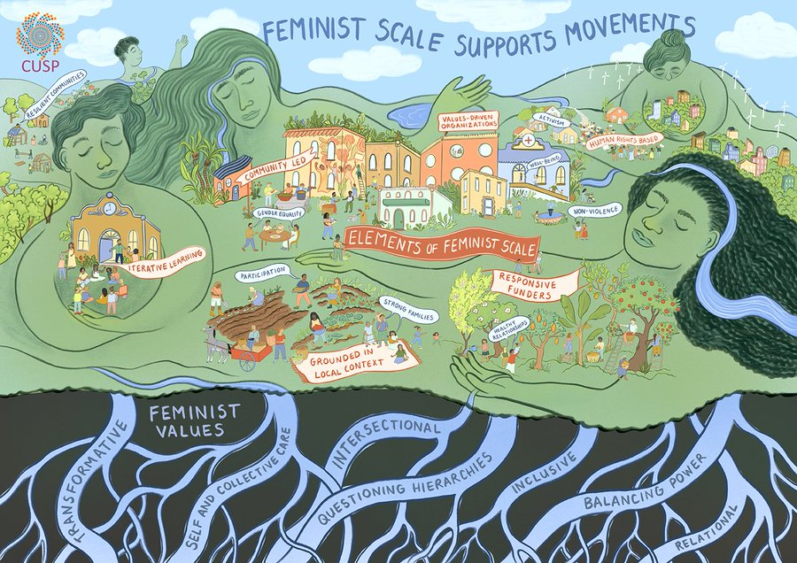
FEMINISM:
As a rural queer feminist sex-worker youth led organization, sharing opportunities with other siblings is always a valid point for our growth. This year we have participated in various feminism movement building activities which have helped us to network and boost our partnerships to have a sustainable future for our community members.
As challenging oppression and patriarchy being a tool for equality, we have stood bold and at the fore front to ensure that gender roles and community entitlement are issues for sensitization within our communities. Through these sessions, we have taken part in the Uganda Feminist Forum (UFF) Visioning and Dreaming group with a guiding concept of improving the building of the UFF.

Slide 12
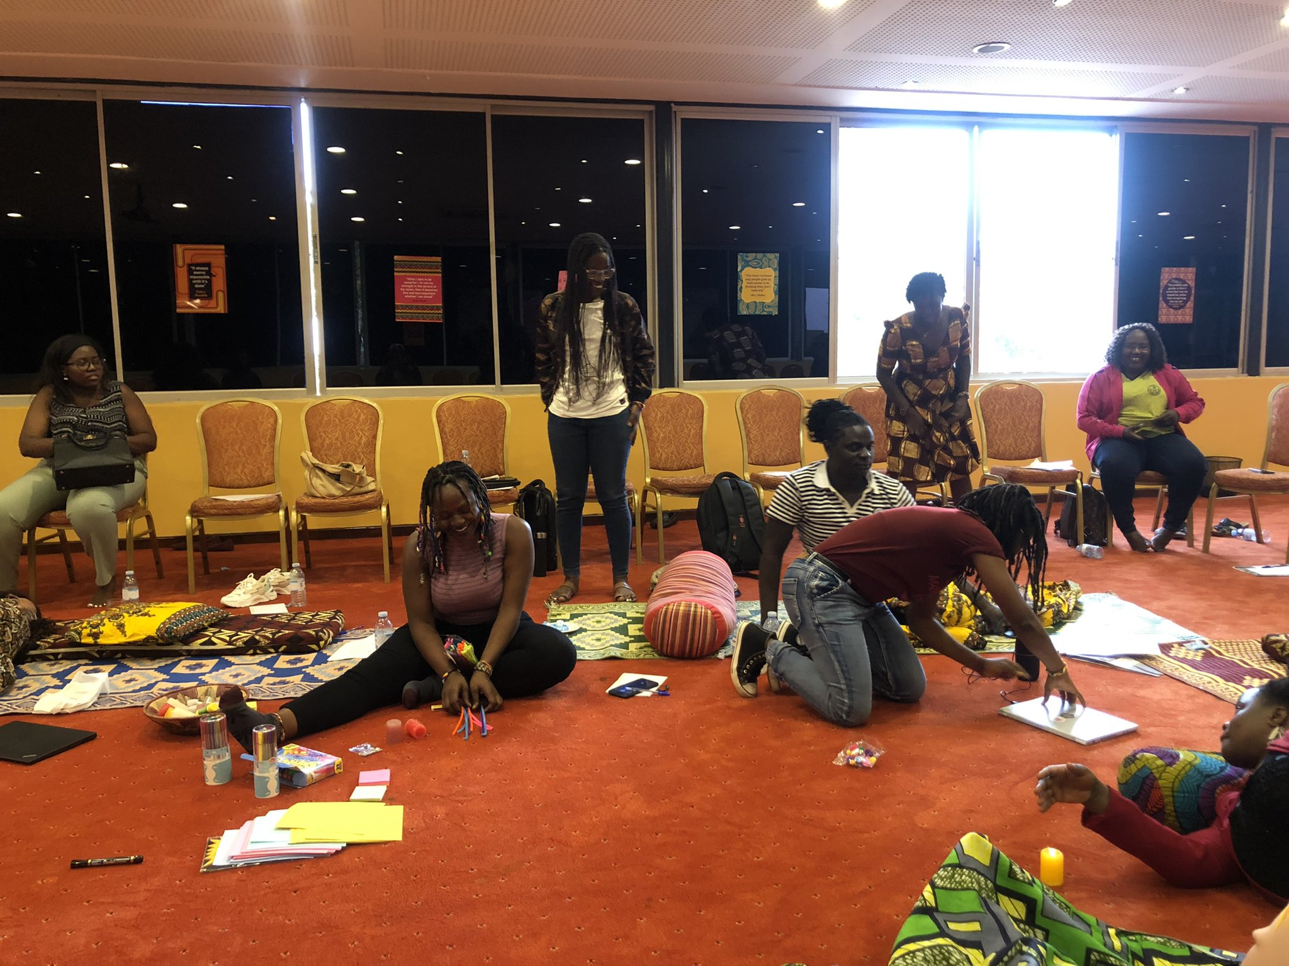
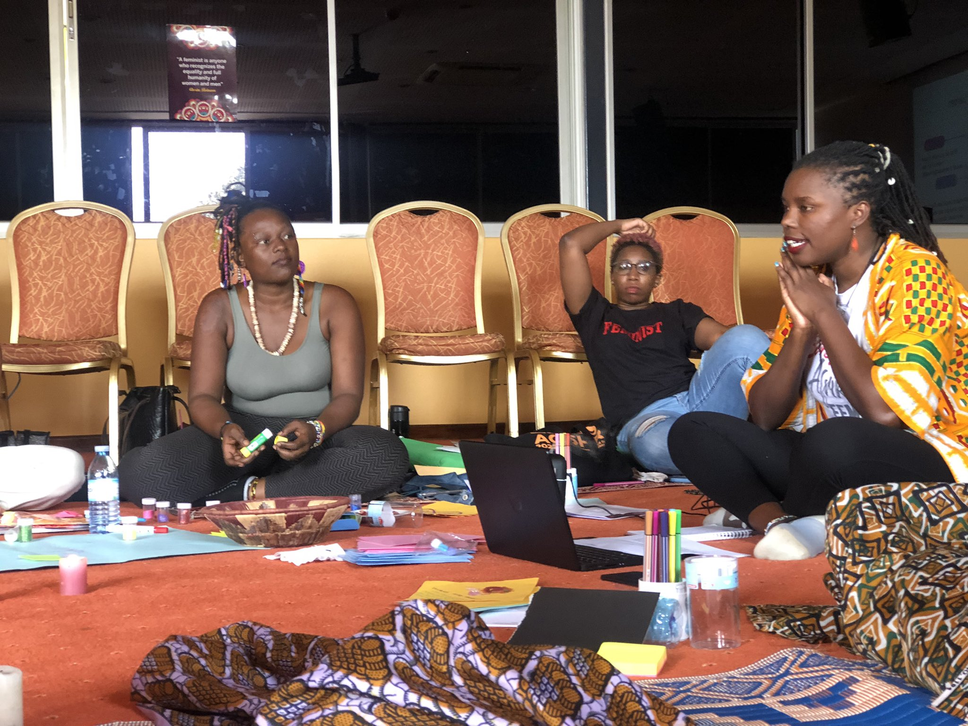
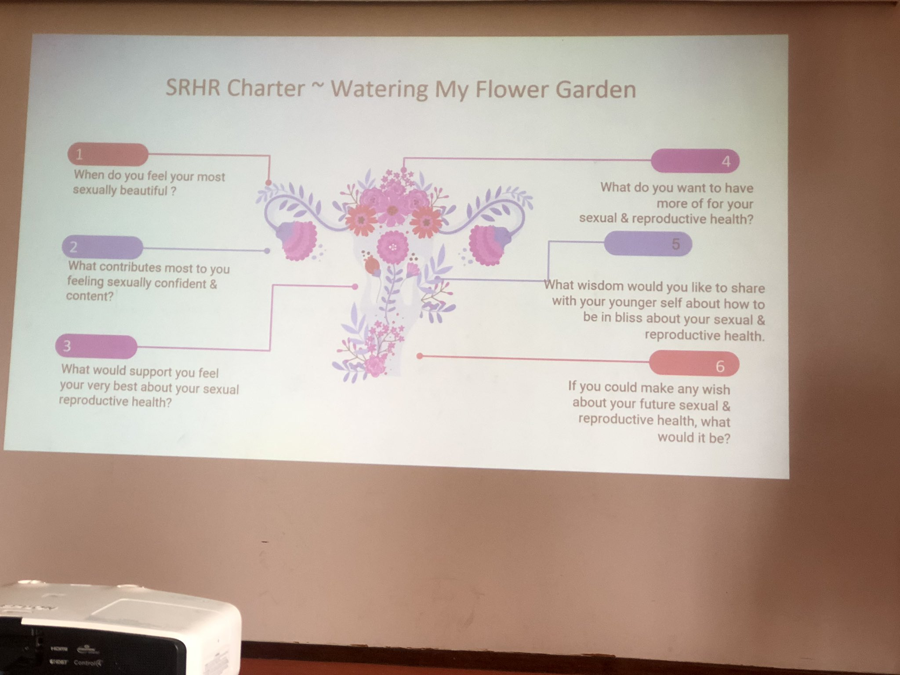
The Rethink and Renergise which was to discuss the Policy Brief to Support Decision Makers as intended to support policy makers to effectively address violence against women (VAW), scope and relevance of the issues among other topics within the report. Our movement building through feminism never stops, but rather grow to engage other areas of community change.

Slide 13
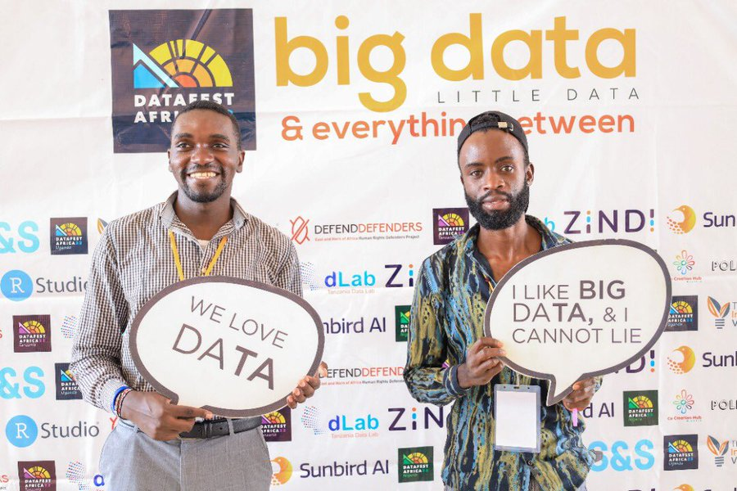
DIGITAL AND DATA SECURITY
Many might ask, Why digital security?
Digital Security refers to various ways of protecting a computer's internet account and files from intrusion by an outside user or a hacker.
Internet security involves the protection of a computer's internet account and files from intrusion by an outside user.
And as CSOs working with minority groups, we have been prone to digital threats and attacks which have been formulated as strategies to demoralize us during our advocacy work and other project implementations.
As an organization, we saw need of protecting our rural HRDs and others by providing digital security knowledge such that we can eliminate on the cyber attacks that majority of us have faced during our works.

Slide 14
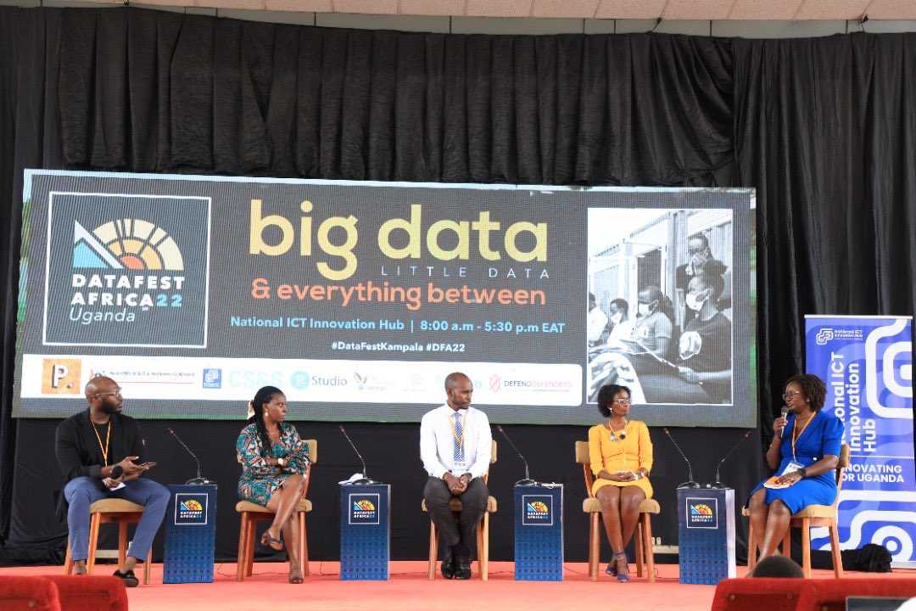
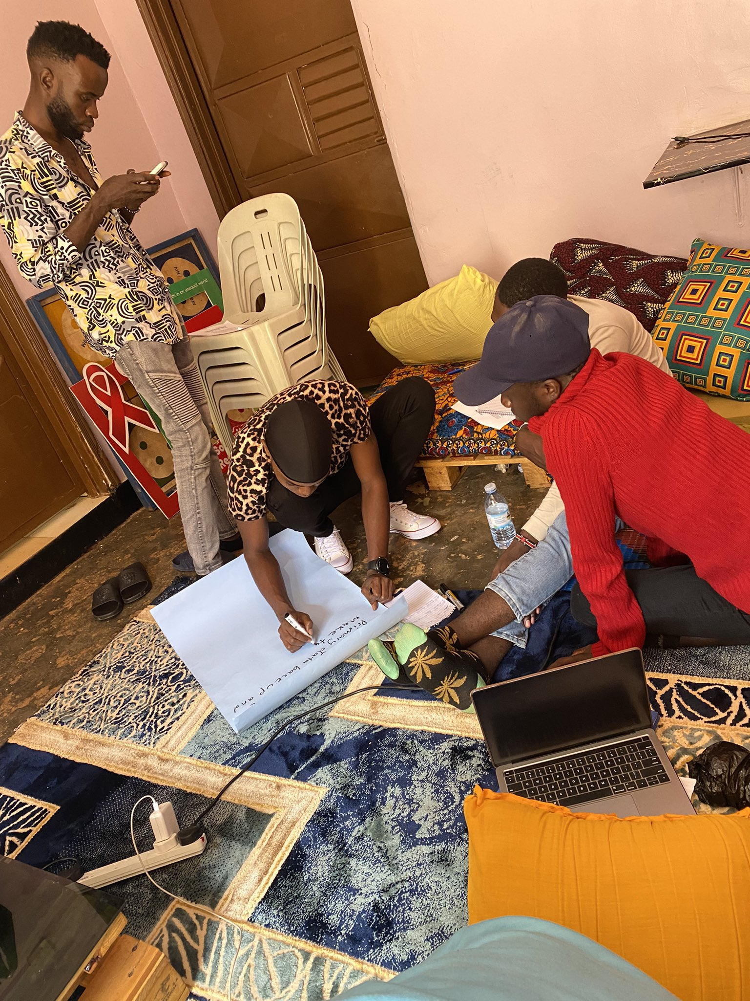
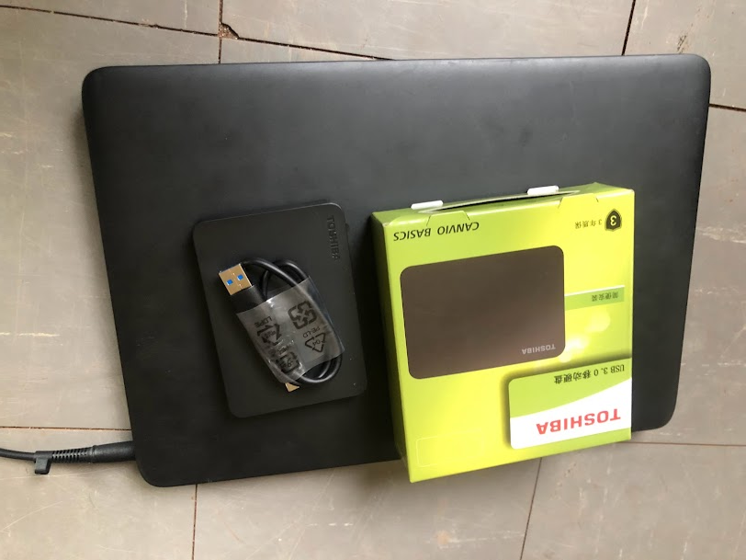
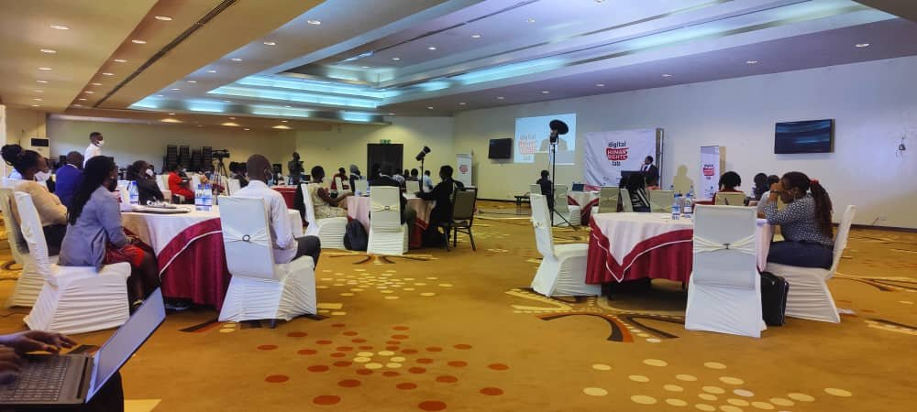
We have engaged with other organizations such as Pollicy, which has organized digital and data security training for CSOs alongside other HRDs, Digital Defenders Partnership - DDP, HIVOS, and DefendDefenders which offered us with resources to conduct capacity enhancement and security strengthening for our both staff and the community members.
We count this as a major achievement since we have managed to educate and share important digital security information with our members and it has lowered the rate of cyber attacks.

Slide 15
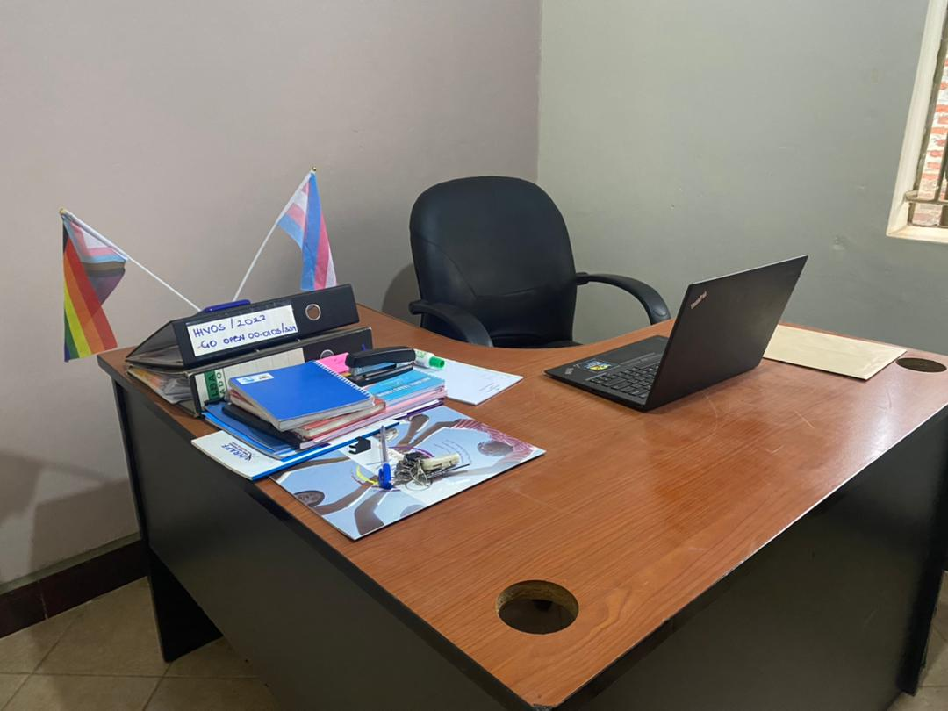
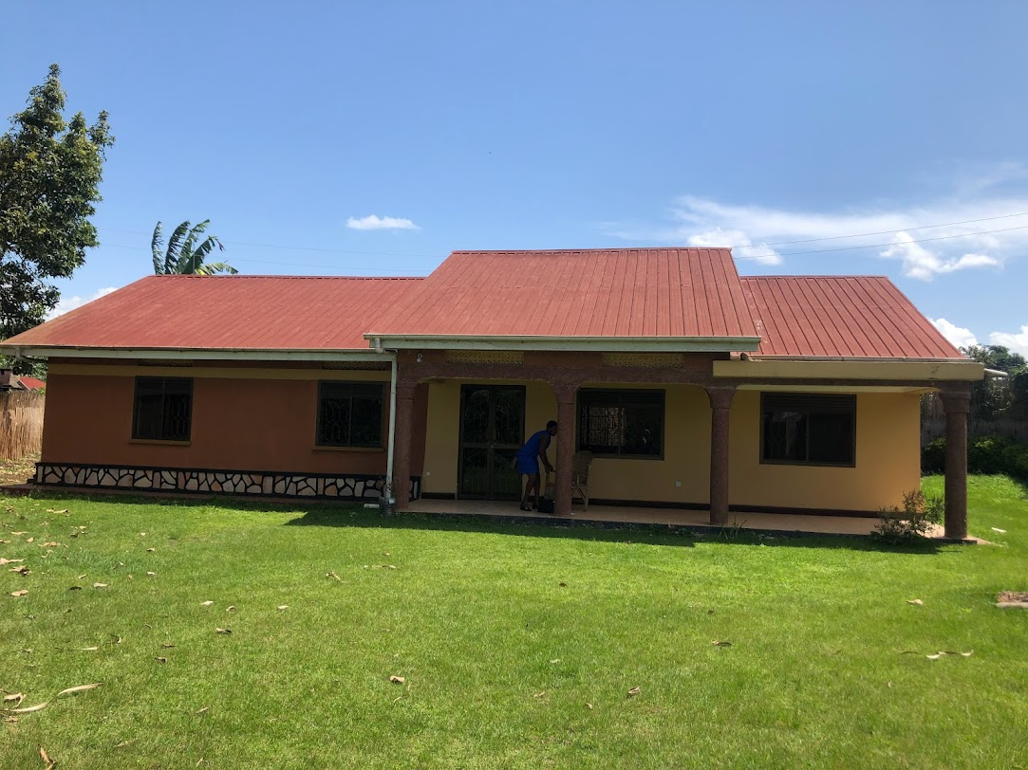
MILESTONE REACHED:

Slide 16

We were able to acquire an office space and furnished for better operation to help us reach our goal. We would like to thanks everyone who has provided us with support, resources, and partnerships which have really made us be the organization you see now and serving the rural queer feminist sex-workers is our devotion and we vow to continue providing all the services we can, but without you, trust me we wouldn't be here.
A special thanks to our Members, Board of Directors, Donors, and Partners.
KUDOS!
~ RAINBOW AFRICA INITIATIVE ~

